Slide 1



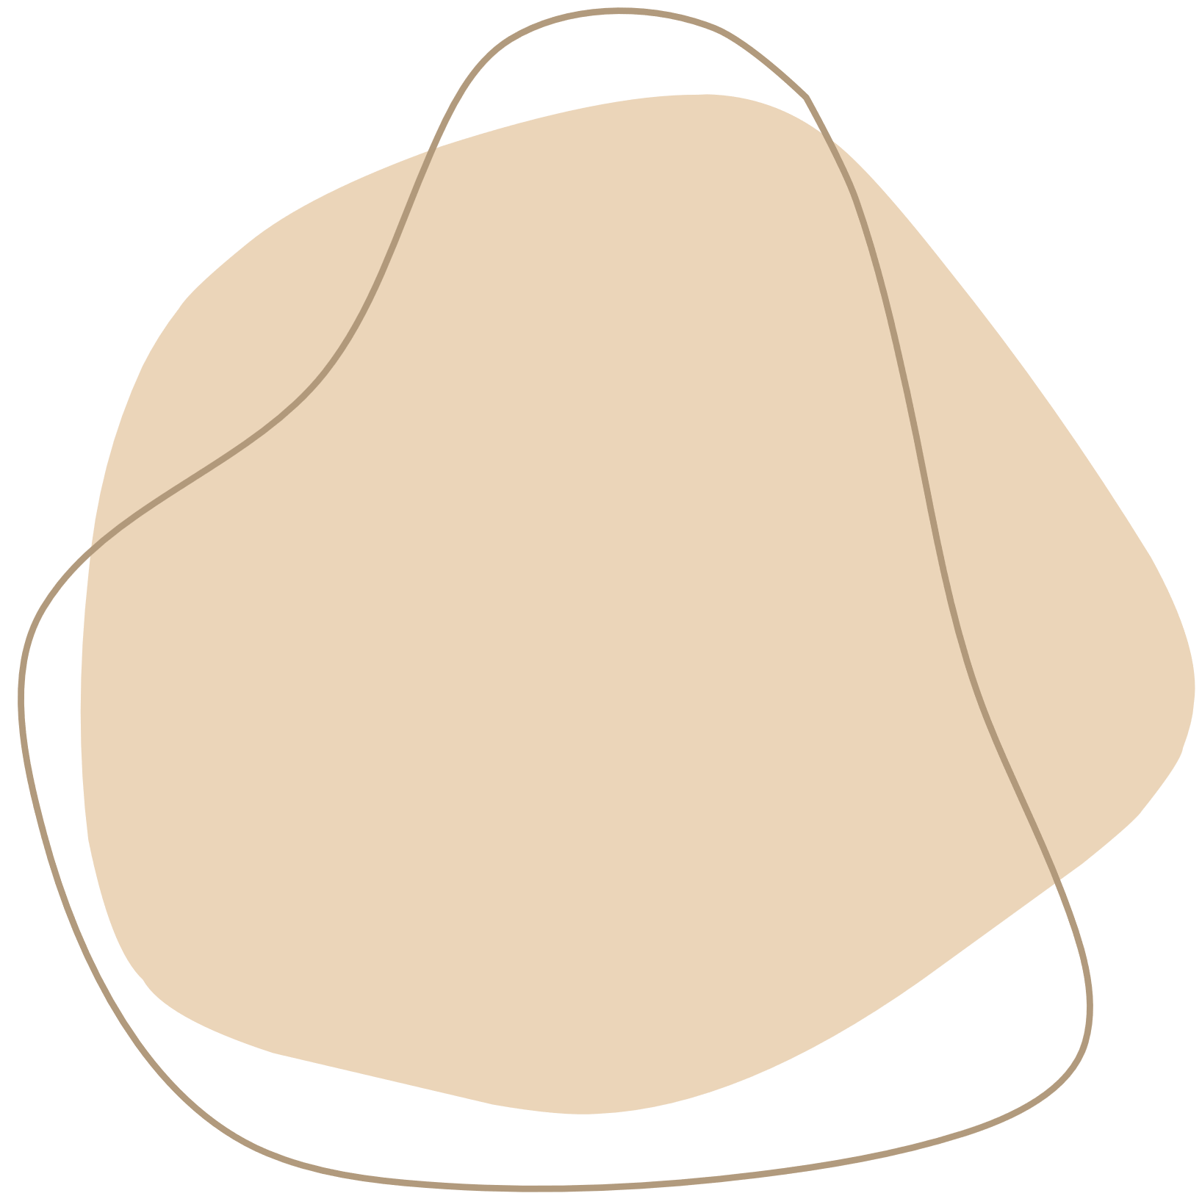



SOUND

Slide 2
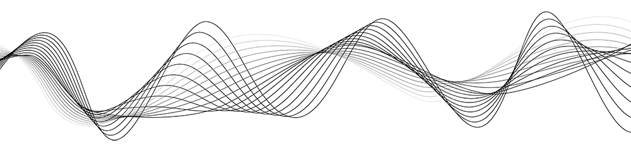
Understanding Sound
SOUND IS A TYPE OF ENERGY MADE BY VIBRATIONS. WHEN AN OBJECT VIBRATES, IT CAUSES MOVEMENT IN SURROUNDING AIR MOLECULES.

Slide 3
HOW SOUND IS PRODUCED
It is produced from a vibrating body. The vibrating body causes the medium (water, air, etc.) around it to vibrate thus producing sound. The sound is produced when something vibrates .

Slide 4
HOW SOUND TRAVELS
Sound travels at different speeds depending on what it is traveling through
Speed of sound in air:343 m/s
Speed of sound in water:1482 m/s
Speed of sound in solid:5960 m/s

Slide 5
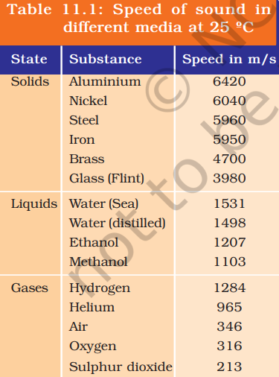
Speed of Sound at different medium

Slide 6
SOUND WAVE PROPERTIES
FREQUENCY
THE NUMBER OF WAVE CYCLES THAT PASS A POINT IN ONE SECOND, IS MEASURED IN HERTZ (HZ). DETERMINES THE PITCH OF A SOUND; HIGHER FREQUENCIES PRODUCE HIGHER-PITCHED SOUNDS. MUSICIANS OFTEN USE "PITCH" INSTEAD OF FREQUENCY.
Wavelength
The distance between two waves. Wavelength is inversely proportional to frequency, so shorter wavelengths produce higher frequencies and higher pitched sounds.
AMPLITUDE
The height of a sound wave determines its loudness. Amplitude is a measure of the amount of energy a wave carries.

Slide 7
REFLECTION OF SOUND
The reflection of sound is when sound waves bounce off a solid or liquid surface and return to the same medium.
Here are some things to know about sound reflection:
Echo: When a sound wave hits a hard surface and bounces back to its source, it's called an echo.
Reverberation: When multiple reflecting surfaces exist in a large area, like valleys or empty rooms, multiple echoes can be heard from a single sound source. This is called reverberation.

Slide 8
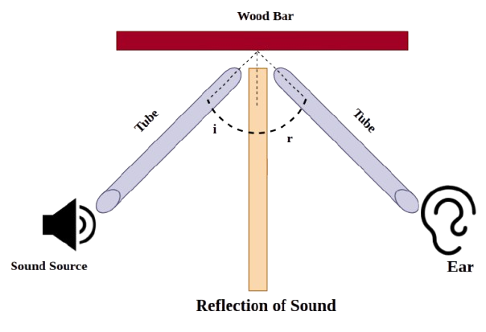
REFLECTION OF SOUND

Slide 9
USES OF MULTIPLE REFLECTIONS
STETHOSCOPE:
A DOCTOR USES A STETHOSCOPE TO HEAR A PATIENT'S HEARTBEAT BY MULTIPLE REFLECTIONS OF SOUND WAVES WITHIN THE STETHOSCOPE'S TUBE, AMPLIFYING THE FAINT SOUNDS FROM THE BODY.
MEGAPHONE:
THE DESIGN OF A MEGAPHONE UTILIZES MULTIPLE REFLECTIONS OF SOUND WAVES WITHIN ITS CONICAL CHAMBER TO PROJECT SOUND IN A FOCUSED DIRECTION, MAKING THE VOICE LOUDER.
SOUND BOARDS:
CURVED SOUND BOARDS PLACED BEHIND THE STAGE IN AUDITORIUMS CAN DIRECT SOUND WAVES FROM THE PERFORMER TOWARDS THE AUDIENCE USING MULTIPLE REFLECTIONS.

Slide 10
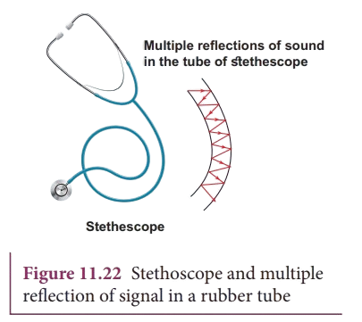
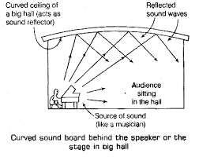
USES OF MULTIPLE REFLECTIONS

Slide 11
HEARING RANGE
THE HUMAN HEARING RANGE IS THE RANGE OF FREQUENCIES THAT THE HUMAN EAR CAN PERCEIVE, WHICH IS TYPICALLY 20 TO 20,000 HERTZ (HZ)
SOUNDS THAT CAN’T BE HEARD BY HUMAN BEINGS
SOUNDS WITH FREQUENCIES BELOW 20 HZ ARE KNOWN AS INFRASOUND.
SOUNDS WITH FREQUENCIES ABOVE 20,000 HZ ARE KNOWN AS ULTRASOUND.

Slide 12
PRACTICAL USES OF SOUND
MEDICAL ULTRASOUND: USED IN HEALTHCARE TO CREATE DETAILED IMAGES OF INTERNAL ORGANS AND TISSUES. IT EMITS HIGH-FREQUENCY SOUND WAVES THAT BOUNCE OFF TISSUES, ENABLING VISUALIZATION OF STRUCTURES LIKE THE FETUS, ABDOMINAL ORGANS, MUSCLES, AND BLOOD VESSELS. IT’S SAFE AND NON-INVASIVE AS IT DOESN’T USE RADIATION.
SONAR (SOUND NAVIGATION AND RANGING): USED IN MARINE APPLICATIONS TO LOCATE UNDERWATER OBJECTS (E.G., SHIPS, REEFS, SEABED). IT SENDS SOUND PULSES AND MEASURES ECHO RETURN TIME TO DETERMINE DISTANCE AND DIRECTION. APPLICATIONS INCLUDE NAVIGATION, OCEAN FLOOR MAPPING, AND OBSTACLE DETECTION

Slide 13
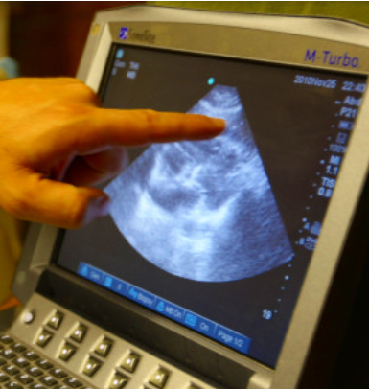
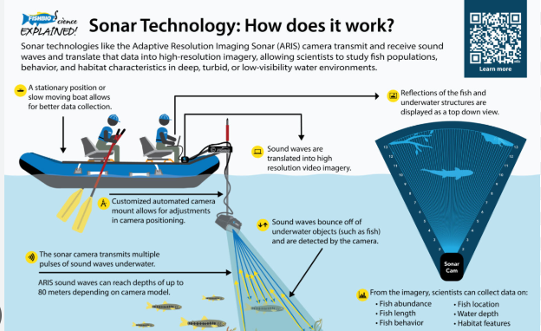
PRACTICAL USES OF SOUND
ULTRASOUND

Slide 14
QUESTIONS?
WHAT IS THE DIFFERENCE BETWEEN AN ECHO AND REVERBERATION?
WHY CAN'T SOUND TRAVEL THROUGH A VACUUM?
WHAT IS SONAR USED FOR?
WHAT IS THE DIFFERENCE BETWEEN LOUDNESS AND PITCH?
WHAT IS THE RELATIONSHIP BETWEEN WAVELENGTH AND FREQUENCY IN A SOUND WAVE?

Slide 15
THANK
YOU

